Slide 1
Community Cookbooks
Find, Explore and View Chef Cookbooks

Slide 2
Objectives
After completing this module, you should be able to
Find cookbooks on the Chef Super Market
Create a wrapper cookbook
Replace the existing default values
Upload a cookbook to Chef Server
Bootstrap a new node that runs the cookbook
Notes:
In this module you will learn how to find cookbooks on the Chef Super Market, create a wrapper cookbook, replace the existing default values, upload a cookbook to Chef Server, and bootstrap a new node that runs the cookbook

Slide 3


Load Balancer
Adding a load balancer will allow us to better grow our infrastructure.
Receives requests and relays them to other systems.
Web Server
Load Balancer
Web Server
Notes:
With a single web server running with our organization, it's now time to talk about the next goal to tackle. We need to setup a load balancer.
A load balancer is able to receive requests and relay them to other systems. In our case, we specifically want to use the load balancer to balance the entire traffic load between one or more systems.
This means we will need to establish a new node within our organization, install the necessary software to make the node a load balancer, and configure it so that it will relay requests to our existing node running iis-demo and to future nodes.

Slide 4
Load Balancer
Work that needs to be accomplished to setup a load balancer within our infrastructure:
Write a iis-lb (load balancer) cookbook.
We will need to establish a new node within our organization to which we apply that cookbook.
iis-lb Cookbook
Node to become load balancer
Chef Server
Notes:
Similar to how we installed and configured iis-demo on our first node, we could do the same thing here with a load balancer. We could read documentation or find tutorials on how to implement IIS as a load balancer. They would likely have us install necessary applications, set the configuration for the applications, write out files, and start the service.
The powershell_script resource, template resource, registry_key resource, and service resource are the core of configuration management on Windows. Most every recipe you write will often use these fundamental resources. We could spend some time focused on composing the cookbook recipe and testing it on our platform with our custom configuration.

Slide 5
Community Cookbooks
Someone already wrote that cookbook?
Available through the community site called Supermarket/
https://supermarket.chef.io
Notes:
But what if we told you someone already wrote that cookbook?
Someone already has and that cookbook is available through the community site called Supermarket. Supermarket is a public repository of all the cookbooks shared by other developers, teams, and companies who want to share their knowledge and hard work with you to save you time.

Slide 6
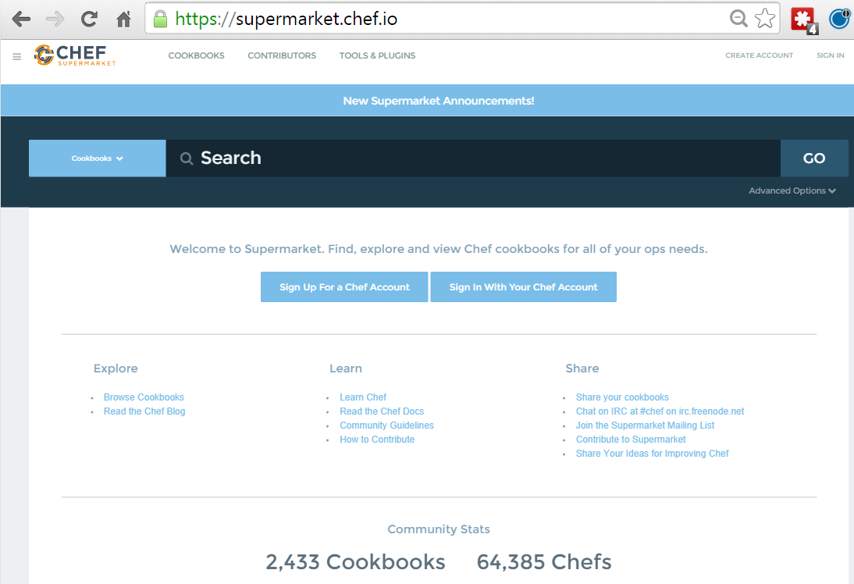
Community Cookbooks
Community cookbooks are managed by individuals.
Chef does not verify or approve cookbooks in the Supermarket.
Cookbooks may not work for various reasons.
Still, there are real benefits to community cookbooks.
Notes:
An important thing to remember is that on the community site are cookbooks managed by individuals. Chef does not verify or approve the cookbooks found in the Supermarket. These cookbooks solved problems for the original authors and then they decided to share them. This means that the cookbooks you find in the Supermarket may not be built or designed for your platform. It may not take into special consideration your needs and requirements. It may no longer be actively maintained.
Even if the cookbook does not work as a whole, there is still value in reading and understand the source code and extracting the pieces you need when creating your own. With all that said, there is a real benefit to the community site. When you find a cookbook that helps you deliver value quickly, it can be a tremendous boon to your productivity. This is what we are going to take advantage of with the iis-lb cookbook.

Slide 7
Load Balancer
Adding a load balancer will allow us to better grow our infrastructure.
Find or Create a Cookbook to Manage a load balancer
Configure the load balancer to send traffic to the new node
Upload cookbook to Chef Server
Bootstrap a new node that runs the iis-lb (load balancer) cookbook
Notes:
Lets find the iis-lb (load balancer) cookbook within the community site to learn more about it.

Slide 8
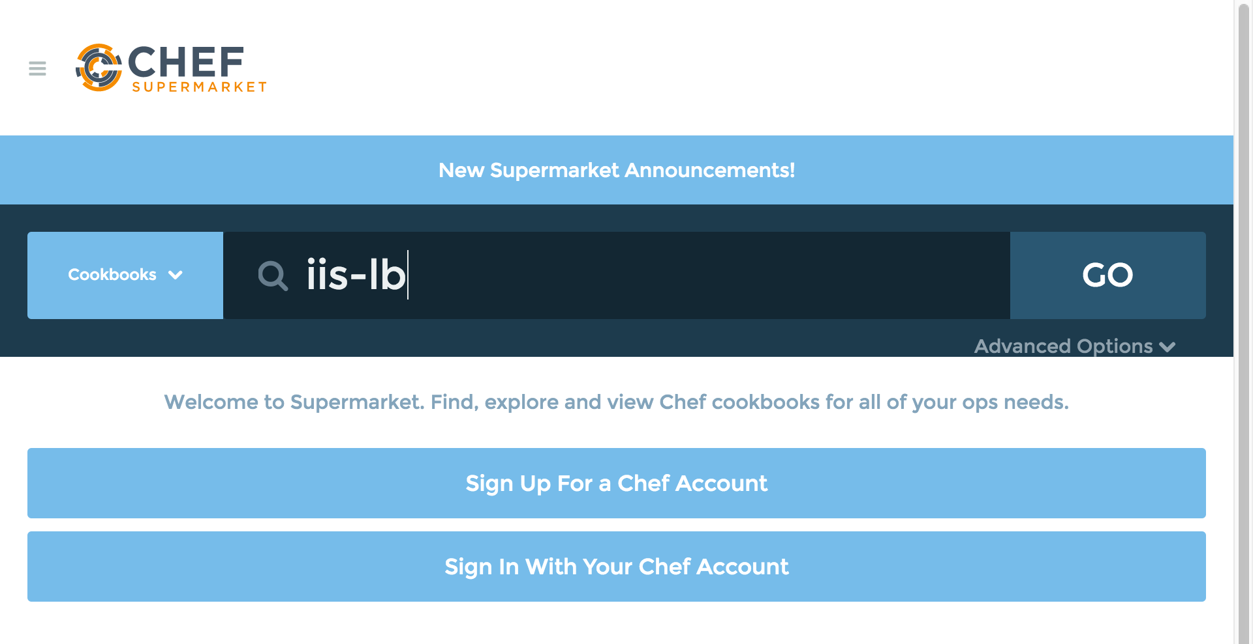
GE: Searching in the Supermarket
From the https://supermarket.chef.io page, type iis-lb in the search field and then click the GO button.
Notes:
From the Supermarket main page type the search term "iis-lb" and the click the GO button.
Below the search term will show us all the matching cookbooks. The iis-lb cookbook is in that result set.

Slide 9
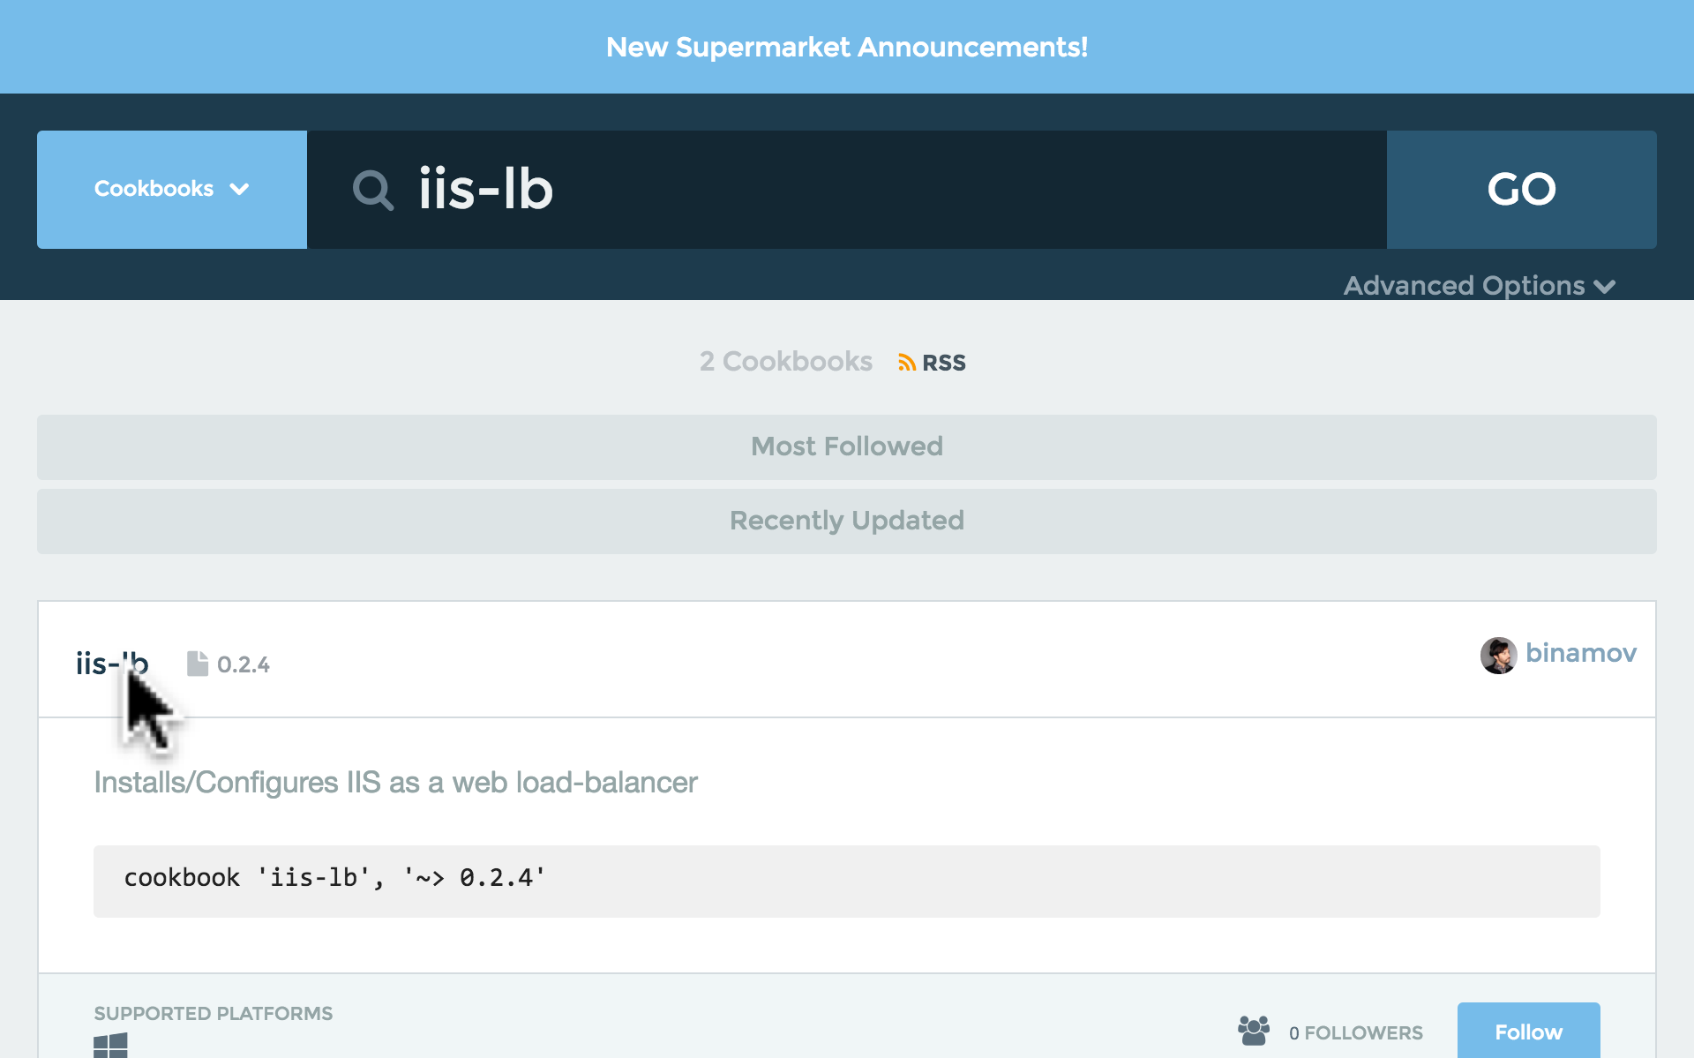
GE: Searching in the Supermarket
Click the resulting iis-lb link.
Notes:
Cookbooks usually map one-to-one to a piece of software and usually are named after the piece of software that they manage. Select the cookbook named iis-lb from the search results.

Slide 10
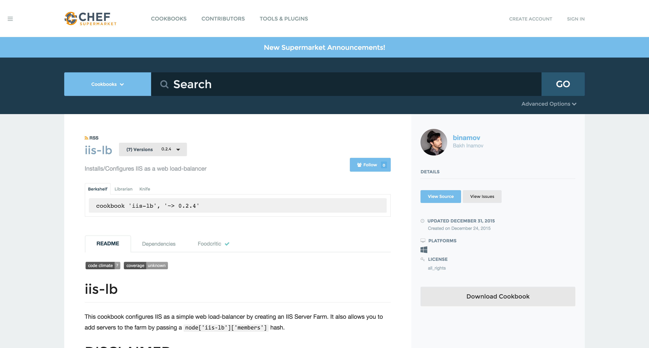
Supermarket Cookbooks
On the right-hand side we can see the individuals that maintain the cookbook...
On the left, we are presented with the various ways we can install the cookbook...
Notes:
At this point you are presented with information that describes the cookbook. Starting on the right-hand side we see the individuals that maintain the cookbook, a link to view the source details, last updated date, supported platforms, licensing, and a link to download the cookbook.
On the left, we are presented with the various ways we can install the cookbook, the README that describes information about the cookbook, any cookbooks that this cookbook may depend on, a history of the changes, and its food critic rating--which is a code evaluator for best practices

Slide 11
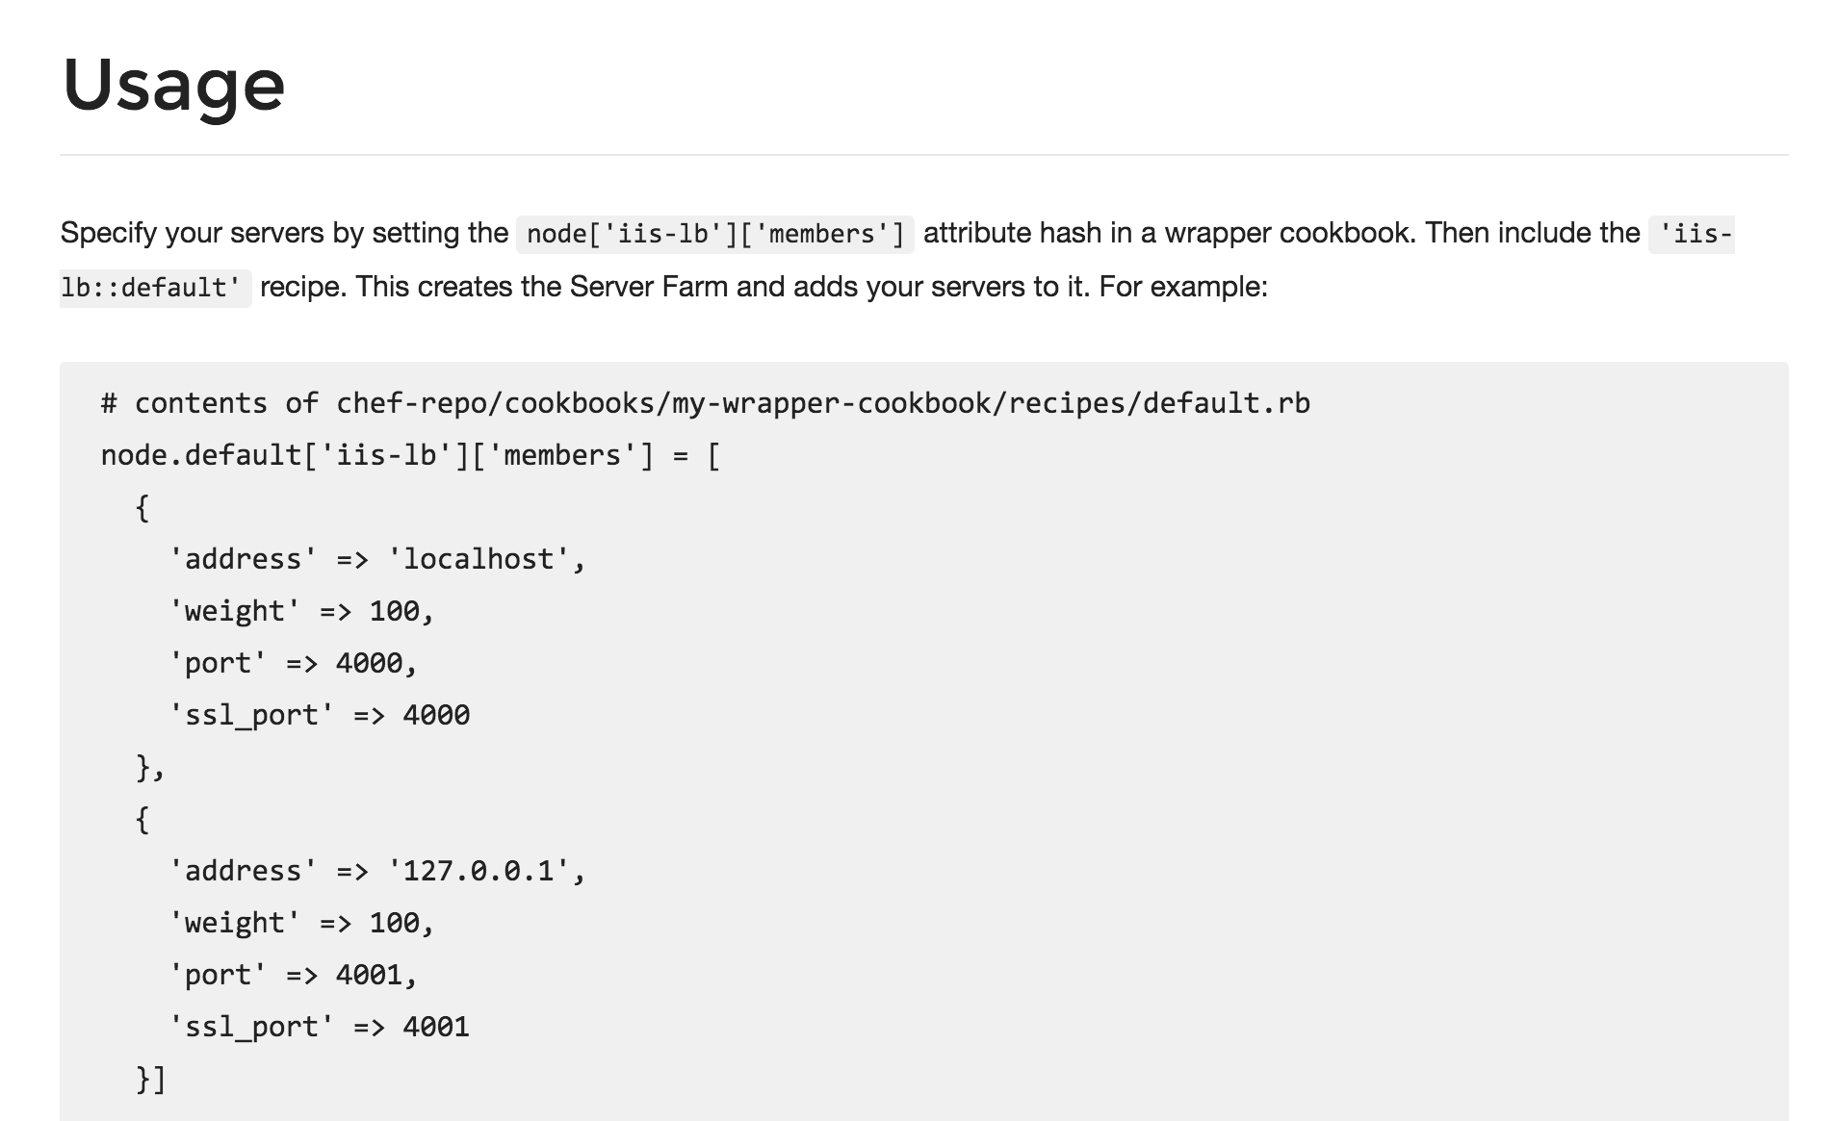
Supermarket Cookbooks
The area to focus most of your attention from the beginning is the README.
Reading and understanding the README at a glance is difficult. It is a skill that comes with time.
Notes:
The area to focus most of your attention from the beginning is the README. The README describes the various attributes that are defined within the cookbook and the purpose of the recipe. This is the same README file found in the cookbooks we currently have within our organization. This one, however, has had far more details added to give new users like us the ability to understand more quickly what the cookbook does and how it does it.
Reading and understanding the README at a glance is difficult. It is a skill that comes with time. For the iis-lb cookbook, there is an defined attribute that establishes the members that receive the proxy requests from the load balancer. This is available in a node attribute available through `node['iis-lb']['members']`.

Slide 12
Supermarket Cookbooks
These node attributes are different than the automatic ones defined by Ohai.
Attributes defined in a cookbook are not considered automatic.
https://docs.chef.io/attributes.html
Notes:
Prior to this point we have seen how node attributes are defined by Ohai but cookbooks also have this ability to define node attributes. These node attributes are different than the ones defined by Ohai as well. Ohai attributes are considered automatic attributes and generally inalienable characteristics about the node.
Attributes defined in a cookbook are not considered automatic. They are simply default values that we may change. There are many ways that we provide new default values for these. One way that we will learn is defining a wrapper cookbook.

Slide 13
Supermarket Cookbooks
Wrapper Cookbook
(New additional attributes)
A wrapper cookbook is a new cookbook that encapsulates the functionality of the original cookbook.
It defines new default values for the recipes.
iis-lb
Cookbook
(Attributes)
https://docs.chef.io/supermarket.html#wrapper-cookbooks
https://www.chef.io/blog/2013/12/03/doing-wrapper-cookbooks-right/
Notes:
A wrapper cookbook is a new cookbook that encapsulates the functionality of the original cookbook but allows us to define new default values for the recipes.
This is a common method for overriding cookbooks because it allows us to leave the original cookbook untouched. We simply provide new default values that we want and then include the recipes that we want to run.
Let's generate our wrapper cookbook named myiis-lb. Traditionally we would name the cookbook with a prefix of the name of our company and then follow it by the cookbook name 'company-cookbook'.

Slide 14
GE: CD and Generate the Cookbook
$ cd ~\chef-repo
$ chef generate cookbook cookbooks\myiis-lb
Compiling Cookbooks...
Recipe: code_generator::cookbook
* directory[C:/Users/sdelfante/chef-repo/cookbooks/myiis-lb] action create
- create new directory C:/Users/sdelfante/chef-repo/cookbooks/myiis-lb
* template[C:/Users/sdelfante/chef-repo/cookbooks/myiis-lb/metadata.rb] action create_if_missing
- create new file C:/Users/sdelfante/chef-repo/cookbooks/myiis-lb/metadata.rb
- update content in file C:/Users/sdelfante/chef-repo/cookbooks/myiis-lb/metadata.rb from none to 899276
(diff output suppressed by config)
* template[C:/Users/sdelfante/chef-repo/cookbooks/myiis-lb/README.md] action create_if_missing
Notes:
Change to your chef-repo directory and then generate your new cookbook.
Instructor Note: The generate cookbook command needs the path in the name of the cookbook here to ensure that it generates the cookbook in the cookbooks directory. Without it the cookbook will be generated within the root of the chef repository. If that happens simply have the learner move the newly generated cookbook into the cookbooks directory.

Slide 15
GE: Create a Dependency in the Cookbook
~\chef-repo\cookbooks\myiis-lb\metadata.rb
name 'myiis-lb'
maintainer 'The Authors'
maintainer_email 'you@example.com'
license 'all_rights'
description 'Installs/Configures myiis-lb'
long_description 'Installs/Configures myiis-lb'
version '0.1.0'
depends 'iis-lb'
+
Notes:
Set up a dependency within your iis-lb cookbook. Establishing this dependency informs the Chef Server that whenever you deliver this cookbook to a node, you should also deliver with it the mentioned dependent cookbooks.
This is important because your cookbook is simply going to set up new default values and then execute the recipes defined in the original cookbook.

Slide 16
Load Balancer
Adding a load balancer will allow us to better grow our infrastructure.
Find or create a cookbook to manage a load balancer
Configure the load balancer to send traffic to the new node
Upload cookbook to Chef Server
Bootstrap a new node that runs the iis-lb cookbook
Notes:
Now that you have the dependency on the iis-lb cookbook in your wrapper cookbook, you need to learn what new default values you need to add to the recipe.

Slide 17
Supermarket Cookbooks
Currently, the iis-lb cookbook assumes that there are two different services running on the localhost at port 4000 and port 4001.
In a moment, you'll need to change that.
https://docs.chef.io/supermarket.html#wrapper-cookbooks
Notes:
Currently the iis-lb cookbook assumes that there are two different services running on the localhost at port 4000 and port 4001. The iis-lb process will relay messages to itself to those two ports.
That is not our configuration. First, we currently only have one system that we want to route traffic. Second, we want to have the traffic routed not to localhost but instead to our webserver, node1, which will have a completely different hostname and IP address.

Slide 18
GE: Capture Node's Public Host Name and IP
$ knife node show --help
knife node show NODE (options)
-a ATTR1 [--attribute ATTR2] , Show one or more attributes
--attribute
-s, --server-url URL Chef Server URL
--chef-zero-host HOST Host to start chef-zero on
--chef-zero-port PORT Port (or port range) to start chef-zero on. Port ranges
-k, --key KEY API Client Key
--[no-]color Use colored output, defaults to false on Windows, true
-c, --config CONFIG The configuration file to use
--defaults Accept default values for all questions
-d, --disable-editing Do not open EDITOR, just accept the data as is
-e, --editor EDITOR Set the editor to use for interactive commands
Notes:
This new default value for the iis-lb members needs to define the information about the webserver node, node1. So you need to capture the node's public host name and public IP address.
The 'knife node show' command will display information about the node. You can ask to see a specific attribute on a node with the –a flag or the --attribute flag.

Slide 19
GE: Capture Node's Public Host Name and IP
$ knife node show node1 -a ipaddress
node1:
ipaddress: 172.31.8.68
Notes:
You can display the IP address of node1 with the '-a' flag and specifying the attribute 'ipaddress'.
With cloud providers that generate machines for you often assign internal IP addresses, those values may not work properly.
Instructor Note: The IP addresses of the nodes that were used during the creation of this training were based on Amazon Web Services (AWS). The address reported by Ohai is often the private, internal address.

Slide 20
AWS VM Instances
The IP address and host name are unfortunately not how we can address these nodes within our recipes.
Notes:
The reason you may need to ask the node for a different set of attributes is that we are using Amazon as a cloud provider for our instances. These instances are displaying the internal IP address when we ask for the ipaddress attribute.
Ohai collects attributes from the current cloud provider and makes them available in an attribute named 'cloud'. We can look at the cloud attribute on our first node and see that it returns for us information about the node.

Slide 21
GE: Capture Node's Public Host Name and IP
$ knife node show node1 -a cloud
node1:
cloud:
local_hostname: ip-172-31-8-68.ec2.internal
local_ipv4: 172.31.8.68
private_ips: 172.31.8.68
provider: ec2
public_hostname: ec2-54-175-46-24.compute-1.amazonaws.com
public_ips: 54.175.46.24
public_ipv4: 54.175.46.24
Notes:
If you use 'knife node show' to display the 'cloud' attribute for node1, you will see the local, private, and public connection information.
Capture and write down the public hostname and the public ipv4 address of node1. You will need this in the recipe you are going to write.

Slide 22
GE: Edit the myiis-lb Default Recipe
~\chef-repo\cookbooks\myiis-lb\recipes\default.rb
#
# Cookbook Name:: myiis-lb
# Recipe:: default
#
# Copyright (c) 2015 The Authors, All Rights Reserved.
include_recipe 'iis-lb::default'
Notes:
First, within the myiis-lb cookbook you will use the include_recipe method to specify the fully-qualified name of the cookbook and recipe that you want to execute. In this case, when you run your wrapped cookbooks recipe, you'll want it to run the original cookbook's default recipe.

Slide 23
GE: Edit the myiis-lb Default Recipe
~\chef-repo\cookbooks\myiis-lb\recipes\default.rb
node.default['iis-lb']['members'] = [
{
'address' => 'localhost',
'weight' => 100,
'port' => 4000,
'ssl_port' => 4000
},
{
'address' => 'localhost',
'weight' => 100,
'port' => 4001,
'ssl_port' => 4001
}]
include_recipe 'iis-lb::default'
+
Notes:
Find the following example code within the README that the author has provided. This example code shows how to override the default values within a recipe. Copy and paste the example code into the default recipe above the include_recipe line.
More modifications are still necessary to override the original recipe and replace it with the values of the systems within our infrastructure.

Slide 24
GE: Edit the myiis-lb Default Recipe
~\chef-repo\cookbooks\myiis-lb\recipes\default.rb
node.default['iis-lb']['members'] = [
{
'address' => 'localhost',
'weight' => 100,
'port' => 4000,
'ssl_port' => 4000
},
{
'address' => 'ec2-52-8-71-11.us-west-1.compute.amazonaws.com',
'weight' => 100,
'port' => 80,
'ssl_port' => 80
}
]
include_recipe 'iis-lb::default'
-
+
Notes:
Remove one of the entries within the members array (shown in red).
Then update the information for the remaining member to include the public ipaddress and hostname for node1 (shown in green).
NOTE: Your details will be different than the values that appear here. Use the `knife node show -a ec2` command to find the public hostname and address.

Slide 25
GE: Edit the myiis-lb Default Recipe
~\chef-repo\cookbooks\myiis-lb\recipes\default.rb
node.default['iis-lb']['members'] = [
{
'address' => 'ec2-52-8-71-11.us-west-1.compute.amazonaws.com',
'weight' => 100,
'port' => 80,
'ssl_port' => 80
}
]
include_recipe 'iis-lb::default'
Notes:
The final recipe should appear like the following (with your custom values). Here we have a default recipe that first replaces the default values with only one default value which is your system.

Slide 26
Load Balancer
Adding a load balancer will allow us to better grow our infrastructure.
Find or create a cookbook to manage a load balancer
Configure the load balancer to send traffic to the new node
Upload cookbook to Chef Server
Bootstrap a new node that runs the iis-lb cookbook
Notes:
You have completed creating the wrapper cookbook. It is time to upload to the Chef Server.

Slide 27
Lab: Upload the Cookbook
Upload the cookbook to the Chef Server
Notes:
As a lab exercise, upload the cookbook to the Chef Server
Instructor Note: Allow 5 minutes to complete this exercise.

Slide 28
Lab: Change in the Cookbook Directory
$ cd ~\chef-repo\cookbooks\myiis-lb
Notes:
Lets review that lab.
You change into the directory for the 'myiis-lb' cookbook.

Slide 29
Lab: Install Cookbook Dependencies
$ berks install
Resolving cookbook dependencies...
Fetching 'myiis-lb' from source at .
Fetching cookbook index from https://supermarket.chef.io...
Using chef_handler (1.2.0)
Installing iis (4.1.5)
Installing iis-lb (0.2.4)
Using myiis-lb (0.1.0) from source at .
Installing webpi (2.0.0)
Using windows (1.39.0)
Notes:
We use the Berkshelf to upload our cookbooks. This is where Berkshelf really shines as a tool.
Run the command "berks install".
When you run this command for a cookbook that has a dependency, you'll see that Berkshelf will download the iis-lb cookbook and its dependencies as well. The iis-lb cookbook is dependent on the build-essential cookbook and the cpu cookbook. If any of those cookbooks had dependencies, berkshelf would find those and download them as well.
Instructor Note: Berkshelf downloads these cookbooks into a common directory within your home path. They are not added alongside your other cookbooks.

Slide 30
Lab: Upload the Cookbook to Chef Server
$ berks upload
Uploaded chef_handler (1.2.0) to: 'https://api.chef.io:443/organizations/bakh'
Uploaded iis (4.1.5) to: 'https://api.chef.io:443/organizations/bakh'
Uploaded iis-lb (0.1.9) to: 'https://api.chef.io:443/organizations/bakh'
Uploaded myiis-lb (0.1.0) to: 'https://api.chef.io:443/organizations/bakh'
Uploaded webpi (1.2.8) to: 'https://api.chef.io:443/organizations/bakh'
Uploaded windows (1.39.0) to: 'https://api.chef.io:443/organizations/bakh'
Notes:
After installing all the necessary dependent cookbooks, we used 'berks upload' to send the cookbook and all its dependencies to the Chef Server. This is again an easier method to manage dependencies instead of manually identifying the dependencies and then uploading each single cookbook at a time.

Slide 31
Lab: Verify the Cookbook Upload
$ knife cookbook list
iis-demo 0.2.1
iis-lb 1.6.6
myiis-lb 0.1.0
chef_handler 1.2.0
iis 4.1.5
webpi 1.2.8
windows 1.39.0
workstation 0.1.0
Notes:
When that is complete you can verify that you've uploaded your cookbook and all of its dependencies.

Slide 32
Load Balancer
Adding a load balancer will allow us to better grow our infrastructure.
Find or create a cookbook to manage a load balancer
Configure the load balancer to send traffic to the new node
Upload cookbook to Chef Server
Bootstrap a new node that runs the iis-lb cookbook
Notes:
The myiis-lb cookbook's default recipe is ready to be assigned to a run list of a node. So we'll need another node. The new load balancer node.

Slide 33
Lab: Bootstrap a Load Balancer
Bootstrap a new node
Update the run list of the new node to include the wrapper proxy server cookbook
RDP to that system and run chef-client
Verify that traffic to the load balancer is relayed to the web server.
Notes:
Bootstrap this node the same as you did before but this time define the run list to converge the myiis-lb's default recipe.
After setting that value, RDP into that node with the provided user name and password.
Then run 'sudo chef-client' to apply the recipes defined in this node's run list.
Then verify that your new node's default website is properly redirecting traffic to the original web node you previously set up.
Instructor Note: Allow 12 minutes to complete this exercise.

Slide 34
Lab: Bootstrap a New Node
$ knife bootstrap windows winrm FQDN2 -x USER -P PWD -N node2
Creating new client for node2
Creating new node for node2
Connecting to ec2-54-210-192-12.compute-1.amazonaws.com
ec2-54-210-192-12.compute-1.amazonaws.com Starting first Chef Client run...
ec2-54-210-192-12.compute-1.amazonaws.com Starting Chef Client, version 12.3.0
ec2-54-210-192-12.compute-1.amazonaws.com resolving cookbooks for run list: []
ec2-54-210-192-12.compute-1.amazonaws.com Synchronizing Cookbooks:
ec2-54-210-192-12.compute-1.amazonaws.com Compiling Cookbooks...
ec2-54-210-192-12.compute-1.amazonaws.com [2015-09-16T17:13:10+00:00] WARN: Node node2 has an empty run list.
ec2-54-210-192-12.compute-1.amazonaws.com Converging 0 resources
ec2-54-210-192-12.compute-1.amazonaws.com
ec2-54-210-192-12.compute-1.amazonaws.com Running handlers:
Notes:
First you bootstrap a new node named node2.

Slide 35
Lab: Validate the New Node
$ knife node show node2
Node Name: node2
Environment: _default
FQDN: WIN-F9R1IJ8VE59
IP: 52.90.82.67
Run List:
Roles:
Recipes:
Platform: windows 6.3.9600
Tags:
Notes:
After the node is bootstrapped, validate that it was added correctly to the organization.

Slide 36
Lab: Define the Run List
$ knife node run_list add node2 'recipe[myiis-lb]'
node2:
run_list: recipe[myiis-lb]
Notes:
Define an initial run list for that node to converge the default recipe of the myiis-lb cookbook.

Slide 37
Lab: Validate the Run List
$ knife node show node2
Node Name: node2
Environment: _default
FQDN: WIN-F9R1IJ8VE59
IP: 52.90.82.67
Run List: recipe[myiis-lb]
Roles:
Recipes:
Platform: windows 6.3.9600
Tags:
Notes:
Ensure the run list has been set correctly for node2.

Slide 38
RDP Woes
Logging into both systems is a pain. We can use another knife tool to allow us to send commands to all of our nodes.
Notes:
We asked you to login to that remote node and run 'sudo chef-client' to apply the new run list defined for that node. This does in fact work but considering that we may need to execute this command for this node and many future nodes, it seems like a lot of windows and commands that we would need to execute.

Slide 39
GE: Using knife winrm
$ knife winrm --help
knife winrm QUERY COMMAND (options)
-a, --attribute ATTR The attribute to use for opening the connection - default is fqdn
-f CA_TRUST_FILE, The Certificate Authority (CA) trust file used for SSL transport
--ca-trust-file
-s, --server-url URL Chef Server URL
--chef-zero-host HOST Host to start chef-zero on
--chef-zero-port PORT Port (or port range) to start chef-zero on. Port ranges like 1000,1010 or 8889-9999 will try all given ports until one works.
-k, --key KEY API Client Key
--[no-]color Use colored output, defaults to enabled
-c, --config CONFIG The configuration file to use
--defaults Accept default values for all questions
Notes:
To make our lives easier, the 'knife' command provides a subcommand named winrm' that allows us to execute a command across multiple nodes that match a specified search query.

Slide 40
GE: Define the Run List
$ knife winrm *:* -x USERNAME -P PASSWORD –a ipaddress "chef-client"
ec2-54-175-46-24.compute-1.amazonaws.com Starting Chef Client, version 12.3.0
ec2-54-210-192-12.compute-1.amazonaws.com Starting Chef Client, version 12.3.0
ec2-54-175-46-24.compute-1.amazonaws.com resolving cookbooks for run list: ["iis-demo"]
ec2-54-210-192-12.compute-1.amazonaws.com resolving cookbooks for run list: ["myiis-lb"]
ec2-54-175-46-24.compute-1.amazonaws.com Synchronizing Cookbooks:
ec2-54-175-46-24.compute-1.amazonaws.com - iis-demo
ec2-54-175-46-24.compute-1.amazonaws.com Compiling Cookbooks...
ec2-54-175-46-24.compute-1.amazonaws.com Converging 3 resources
ec2-54-175-46-24.compute-1.amazonaws.com Recipe: iis-demo::server
ec2-54-210-192-12.compute-1.amazonaws.com Synchronizing Cookbooks:
ec2-54-210-192-12.compute-1.amazonaws.com - build-essential
ec2-54-210-192-12.compute-1.amazonaws.com - cpu
Notes:
There are a lot of options for defining the search criteria that we will continue to explore. The most important criteria in this instance is star-colon-star. This means that we want to issue a command to all nodes.
So if you want to execute a "sudo chef-client" run for all of your nodes, you should write out this command.
You would need to provide the user name to log into the system, the password for that system, and then finally the command to execute.
In this way, you could easily ask your nodes to update from your current workstation as long as they all have the same login credentials. For more security, you should likely use keys and forego specifying a username and password

Slide 41
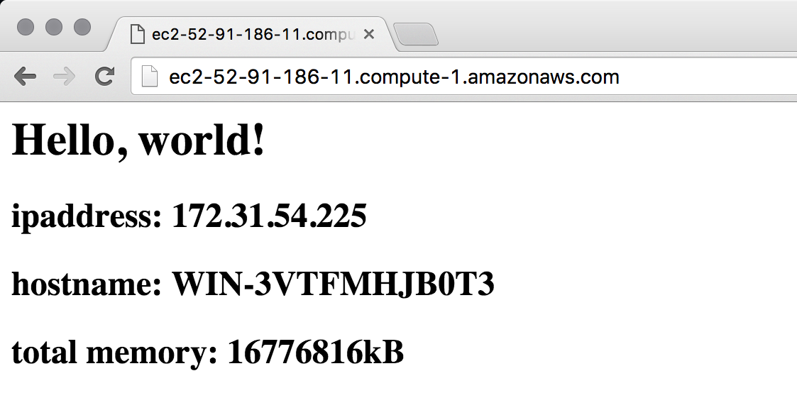
GE: Testing Your Websites
URL of load balancer.
Output from the web server.
Notes:
Point a web browser to the URL or public IP address of your load balancer. It should display the web page of the web server node that the load balancer is configured to serve.

Slide 42
Load Balancer
Adding a load balancer will allow us to better grow our infrastructure.
Find or create a cookbook to manage a load balancer
Configure the load balancer to send traffic to the new node
Upload cookbook to Chef Server
Bootstrap a new node that runs the iis-lb cookbook
Notes:
With your node running the myiis-lb's cookbook's default recipe--relaying traffic to your first node running the iis-demo cookbook's default recipe--you have moved closer to creating the original topology we set out to define today.

Slide 43
Discussion
What are the benefits and drawbacks of the Chef Super Market?
Is your team able to leverage community cookbooks? Is the team able to contribute to community cookbooks?
Why do you use a wrapper cookbook? When might you decide to not wrap the cookbook?
Notes:
Answer these questions.
With your answers, turn to another person and alternate asking each other asking these questions and sharing your answers.

Slide 44
Q&A
What questions can we help you answer?
Chef Super Market
Wrapper Cookbooks
Node Attributes
knife winrm
Notes:
What questions can we help you answer?
In general or about specifically about Chef Super Market, wrapper cookbooks, node attributes, the 'knife winrm' command.

